Slide 1
Car Price Prediction
Presented by:
Lalbiak Zauva

Slide 2
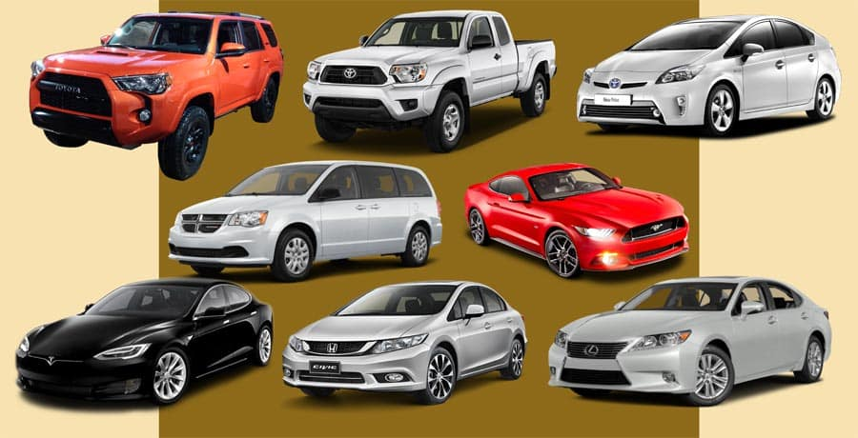
Introduction
With the covid 19 impact in the market, we have seen lot of changes in the car market. Now some cars are in demand hence making them costly and some are not in demand hence cheaper. One of our clients works with small traders, who sell used cars.
With the change in market due to covid 19 impact, our client is facing problems with their previous car price valuation machine learning models. So, they are looking for new machine learning models from new data. We have to make car price valuation model.

Slide 3
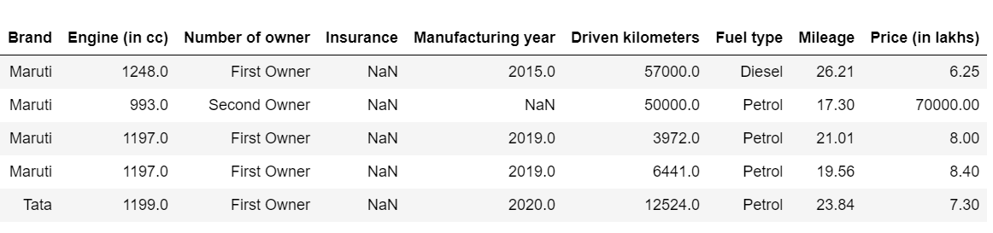
Introduction
In this project, data is collected from different cities including Ahmedabad, Bangalore and Mumbai. We have over 5511 rows with 9 features including the target variable (Price).

Slide 4
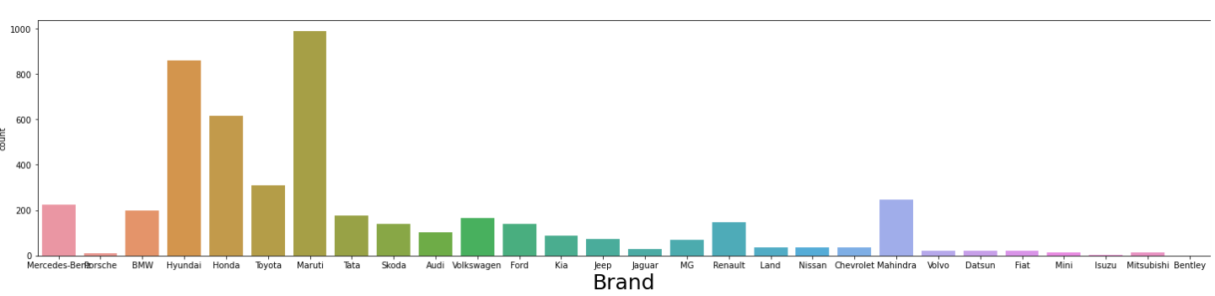
Exploratory Data Analysis
After dealing the null values, we can now visualize the data and understand them better. Here, Maruti has the highest sales followed by Hyndai and Honda.

Slide 5
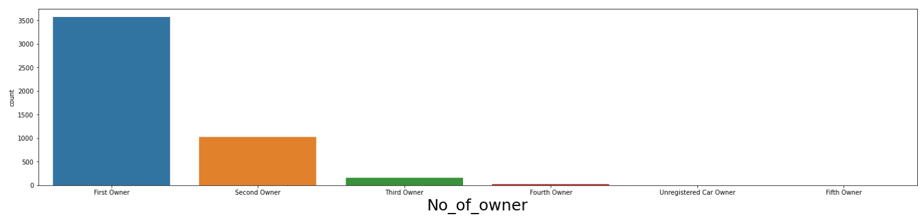
Exploratory Data Analysis
Clearly, most people prefer to buy first-owner cars and hence this makes them more expensive than second owner cars.

Slide 6
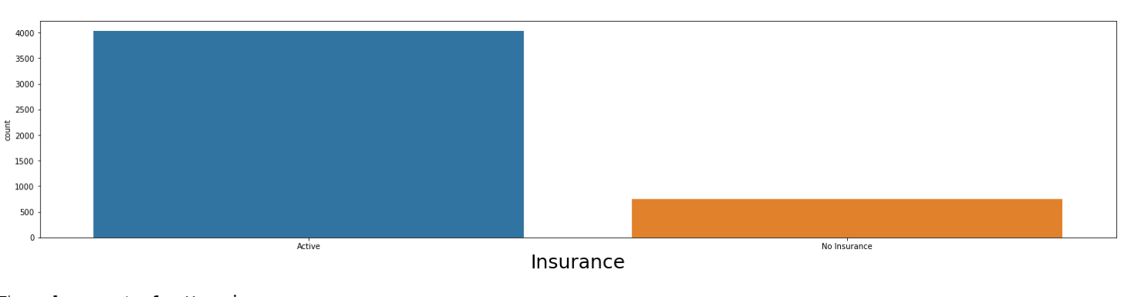
Exploratory Data Analysis
Active insurance adds up value to the car and would be more expensive than ‘no insurance’ cars.

Slide 7
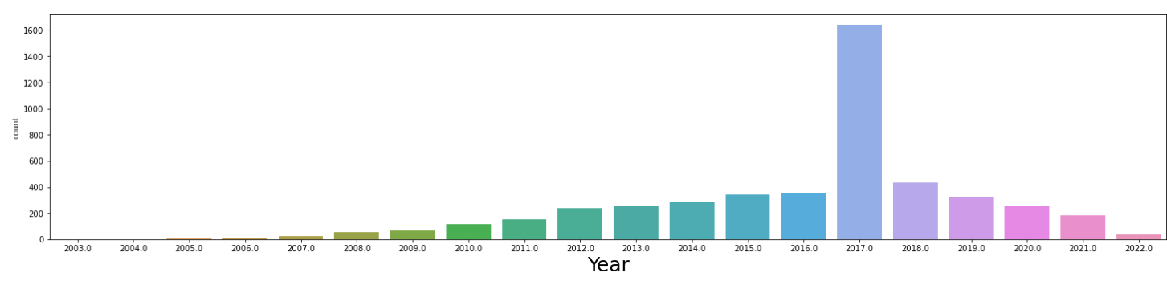
Exploratory Data Analysis
2017 model has the highest sales. This could imply that years before 2017 would be too old for most customers; and years after 2017 are rather new, but would be expensive, and so most customers would not prefer them and so 2017 model cars could be the right year for the car model.

Slide 8
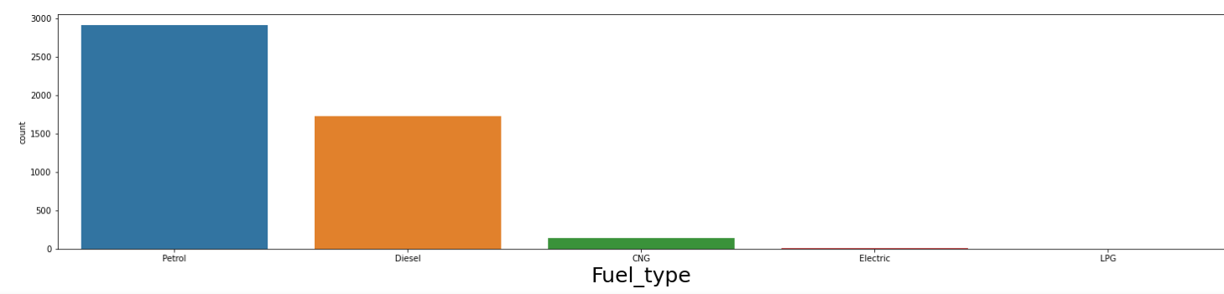
Exploratory Data Analysis
Petrol using cars has the highest sales followed by that of diesel. Petrol using cars are the most common used-cars and people also prefer them and hence price will be higher than the other fuel consuming cars.

Slide 9
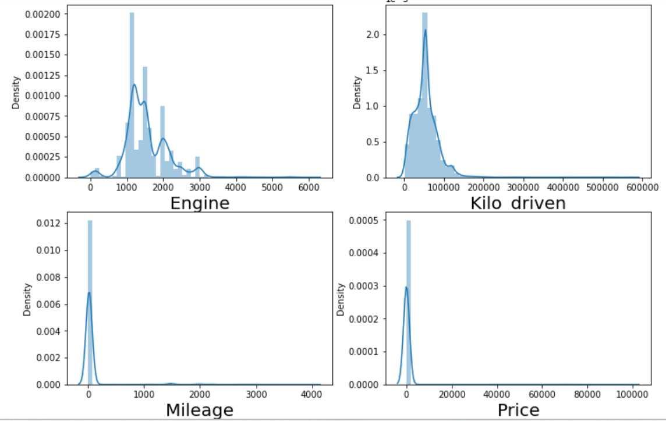
Exploratory Data Analysis
Now, plotting the distribution plot for the continuous data, we see that there is so much skewness in the data

Slide 10
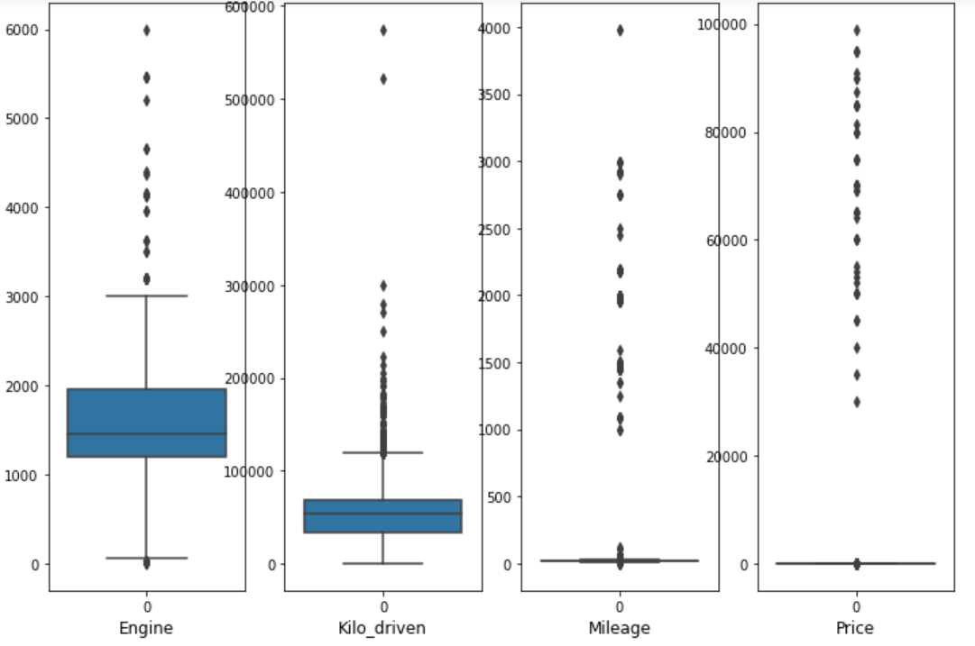
Data Preprocessing
So, we need to handle this using box-plot and remove the outliers.

Slide 11
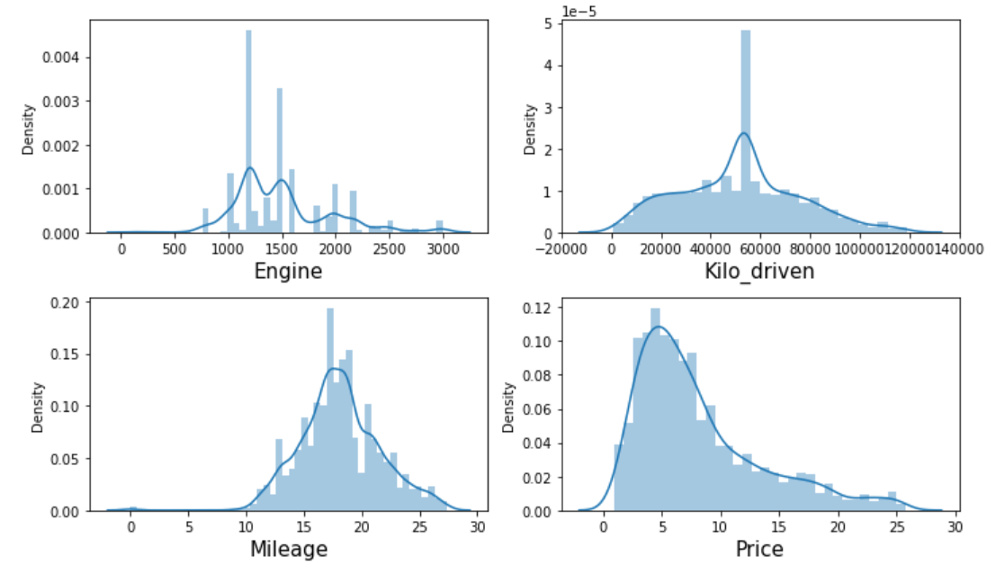
Data Preprocessing
Using IQR (inter quartile range), we can identify the outliers and remove them.
After removing the outliers, the distribution plot looks like a normal distribution:

Slide 12
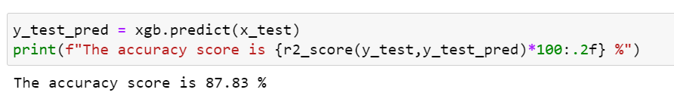
Model Building
Since we are dealing with a regression problem, we have to calculate the R2 score.
Then we need to split the data into train data and test data.
After trying different algorithms, XGB Regressor algorithm gives the best result. So, we will choose this algorithm for our model and to make prediction and this gives us 87.83 % accuracy.

Slide 13
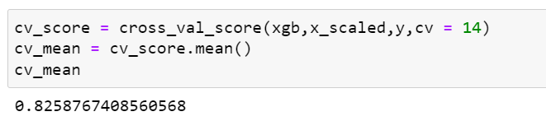
Cross Validation
We need to perform cross validation of the performance of our model to see whether our model overfits or not. The cross-validation score here looks good and our model does not overfit.

Slide 14
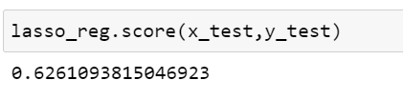
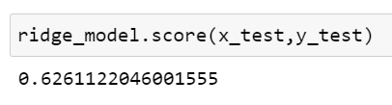
Regularization
Also, the L1 form and L2 form has pretty much the same value which also tells us that our model does not overfit.

Slide 15
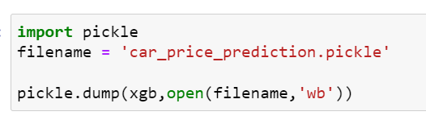
Saving the model
Now we can save our model for future predictions

Slide 16
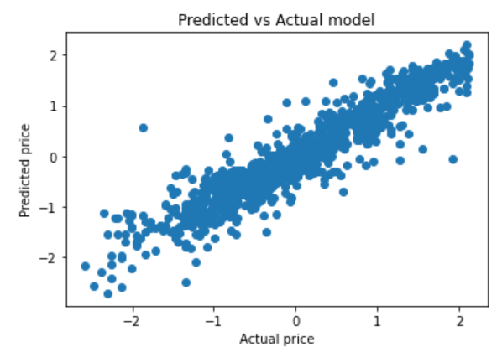
Scatter plot of actual vs prediction

Slide 17
Conclusion
The features that we are dealing with (8 features excluding the target) are all important factors and have strong correlation with the target variable. So, we are not dropping any column since they are all important. Most people do not prefer to buy very cheap cars since the quality and condition of the car would also be quite bad. They neither want to buy expensive cars even though they are still in good conditions. Most people rather want to buy cars of moderate price which still looks good.
Out of different brands, the most popular brand is Maruti. Since our target variable is continuous, we perform some checks on the accuracy score, but we find that our model works pretty well and does not overfit. Using XGB Regressor algorithm, we get an R2 score of 87.83 %.

